Slide 1
Raju Halder
Assistant Professor
Department of Comp. Sc. & Engg.
Indian Institute of technology Patna
halder@iitp.ac.in

Slide 2
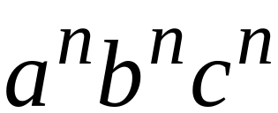

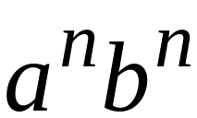



The Language Hierarchy
?
?
Context-Free Languages
Regular Languages

Slide 3
Languages accepted by
Turing Machines
Context-Free Languages
Regular Languages

Slide 4







A Turing Machine
infinite length Tape
Input string
Blank symbol
......
......
1. Reads a symbol
2. Writes a symbol
3. Moves Left or Right
head
Write
Read
Move Right
Control Unit

Slide 5
Acceptance
If machine halts
in an accept state
Accept Input
string
If machine halts
in a non-accept state
or
If machine enters
an infinite loop
Reject Input
string

Slide 6





Decidable Language:
A language is decidable if there is a Turing machine (decider) which accepts and halts on every input string.
For any string :
halts in an accept state
halts in a non-accept state
is Also known as recursive languages.

Slide 7

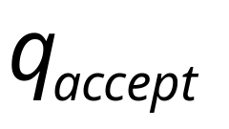
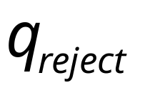
For a decidable language :
Decision
On Halt:
Decider for
Accept
Input
string
Reject
For each input string, the computation
halts in the accept or reject state

Slide 8


Problem:
Is number prime?
Corresponding language:
We will show it is decidable

Slide 9

Can we have such a Decider?
Decider for PRIMES
YES
Input number
is prime?
(Accept)
(Input string)
NO
(Reject)

Slide 10


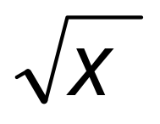

Decider for :
On input number :
Divide with all possible numbers
between and
If any of them divides
Then reject
Else accept

Slide 11





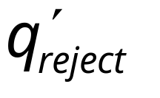
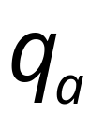


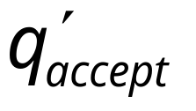

Theorem:
If a language is decidable,
then its complement is decidable too
Proof:
Build a TM that accepts and halts on every input string.

Slide 12
A computational problem is decidable
if the corresponding language is decidable
We also say that the problem is solvable

Slide 13
Undecidable Languages

Slide 14

A language is Turing-Acceptable
if there is a Turing machine
that accepts
Also known as: Turing-Recognizable
or
Recursively-enumerable
languages

Slide 15
For any string :
halts in an accept state
halts in a non-accept state
or loops forever

Slide 16
For a Turing-Acceptable language :
Turing Machine for
Input
string
It is possible that for some input string
the machine enters an infinite loop

Slide 17
Theorem 1:
If Decides then Recognizes .
But not necessarily vice versa.
Theorem 2:
If is Decidable then is Turing- Recognizable.
But not necessarily vice versa.

Slide 18
Theorem 3:
If is Decidable then is Decidable.
Theorem 4:
is Decidable if and only if and both Turing-Recognizable.

Slide 19
Four possibilities:
and both Turing-recognizable.
    Equivalently, is Turing-decidable.
is Turing-recognizable, is not.
is Turing-recognizable, is not.
Neither nor is Turing-recognizable.
Cardinality Argument/Cantor's diagonal argument (countable TM/uncountable L)

Slide 20
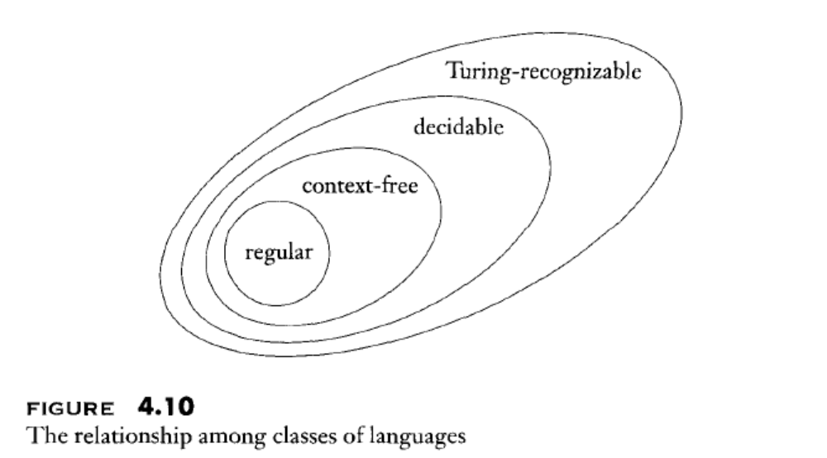

Slide 21
Undecidable Languages
undecidable language = not decidable language
There is no decider:
there is no Turing Machine
which accepts the language
and makes a decision (halts)
for every input string
(machine may make decision for some input strings)

Slide 22
For an undecidable language, the corresponding problem is undecidable (unsolvable):
there is no Turing Machine (Algorithm)
that gives an answer (yes or no)
for every input instance
(answer may be given for some input instances)

Slide 23
We will prove that two particular problems
are unsolvable:
Halting problem
Membership problem

Slide 24


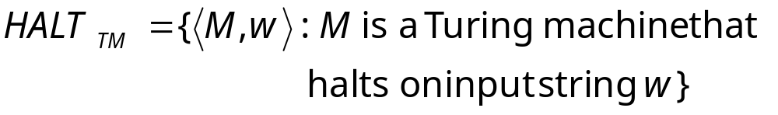
Halting Problem
Input:
Turing Machine
String
Question:
Does halt while
processing input string ?
Corresponding language:

Slide 25

Theorem:
is undecidable
(The halting problem is unsolvable)
Proof:
Basic idea:
Suppose that is decidable;
we will prove that
every decidable language
is also Turing-Acceptable
A contradiction!

Slide 26

We can actually show:
Turing-Acceptable
Decidable

Slide 27

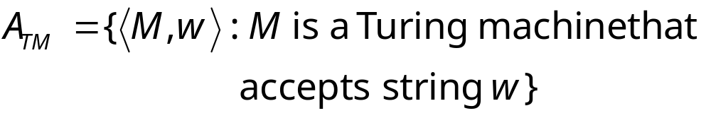
Membership Problem
Input:
Turing Machine
String
Question:
Does accept ?
Corresponding language:

Slide 28
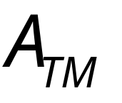
Theorem:
is undecidable
(The membership problem is unsolvable)
Proof:
Basic idea:
We will assume that is decidable;
We will then prove that
every decidable language
is Turing-Acceptable
A contradiction!

Slide 29
We can actually show:
Turing-Acceptable
Decidable

Slide 30




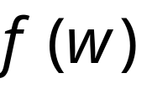

Reductions
Problem is reduced to problem
If is decidable then is also decidable
If is undecidable, then is also undecidable

Slide 31
Rice Theoem

Slide 32



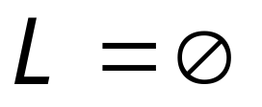
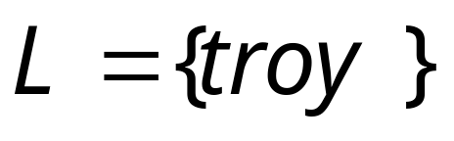
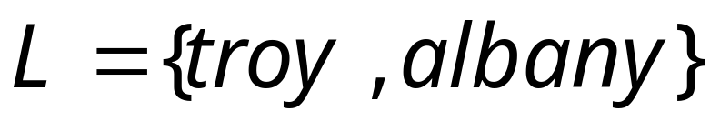
Non-trivial property:
A property possessed by some
Turing-acceptable languages
but not all
Example:
: is empty?
YES
NO
NO

Slide 33
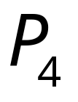

Trivial property:
A property possessed by ALL
Turing-acceptable languages
Examples:
: has size at least 0?
True for all languages
: is accepted by some
Turing machine?
True for all
Turing-acceptable languages

Slide 34

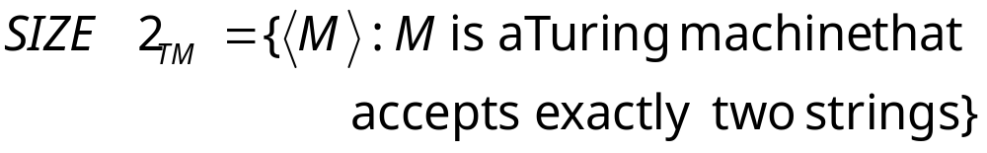
Let be a Turing-acceptable language
has size 2?
This can be generalized to all non-trivial
properties of Turing-acceptable languages

Slide 35
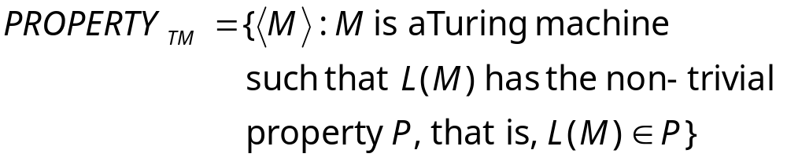

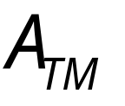
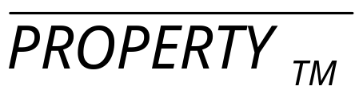
Rice’s Theorem:
is undecidable
(the non-trivial property problem is unsolvable)
Proof:
Reduce (membership problem)
to
or

Slide 36
Time Complexity

Slide 37
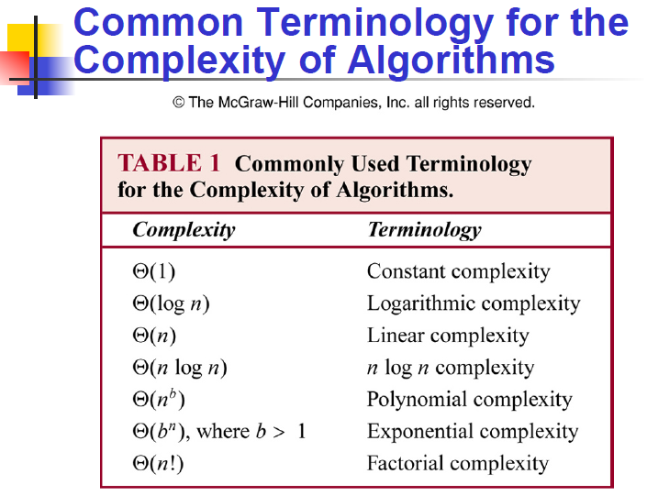


Slide 38
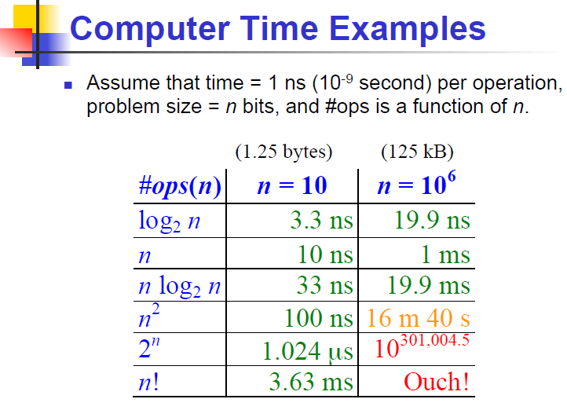

Slide 39
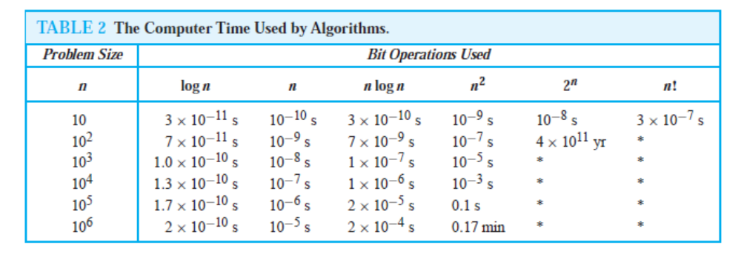
The Computer Time Used by Algorthms
Time=1 ns
Asterisk: 10^100 years

Slide 40
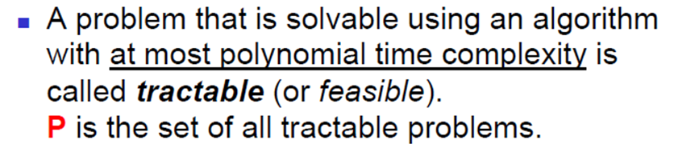
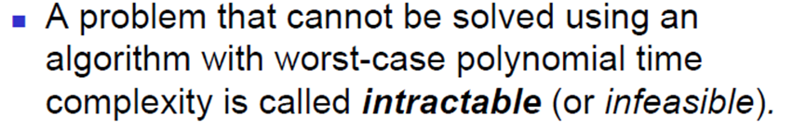
Tractable Vs. Non-Tractable

Slide 41
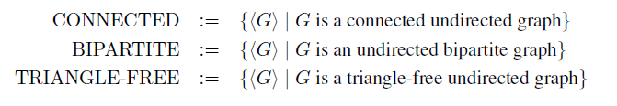
Complexity Class P

Slide 42
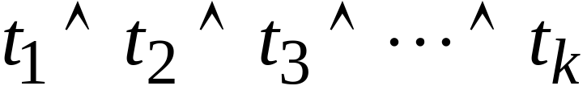
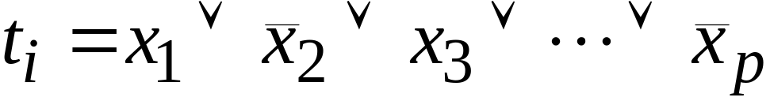
Example: The Satisfiability Problem
Boolean expressions in
Conjunctive Normal Form:
clauses
Variables
Question: is the expression satisfiable?

Slide 43
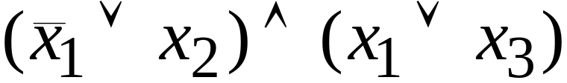
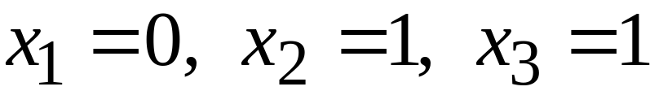
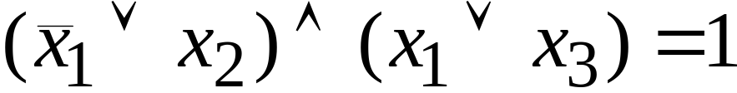
Example:
Satisfiable:

Slide 44
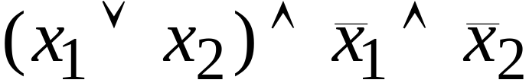
Example:
Not satisfiable

Slide 45
Exponential time complexity
Algorithm:
search exhaustively all the possible
binary values of the variables

Slide 46
Example:
The satisfiability problem
Non-Deterministic algorithm:
Guess an assignment of the variables
Check if this is a satisfying assignment

Slide 47

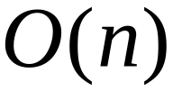
Time for variables:
Guess an assignment of the variables
Check if this is a satisfying assignment
Total time:

Slide 48


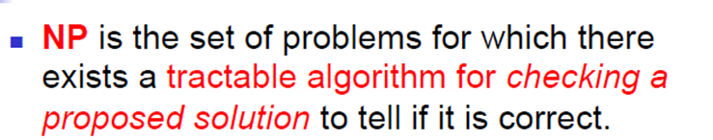
The satisfiability problem is an - Problem

Slide 49
Example: the Hamiltonian Path Problem
s
t
Question: is there a Hamiltonian path
from s to t?

Slide 50
s
t
YES!

Slide 51
The clique problem
Does there exist a clique of size 5?

Slide 52
The clique problem
Does there exist a clique of size 5?

Slide 53


Observation:
Deterministic
Polynomial
Non-Deterministic
Polynomial
Open Problem:
WE DO NOT KNOW THE ANSWER

Slide 54
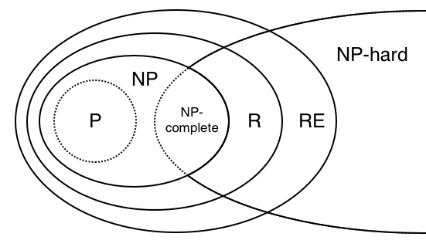
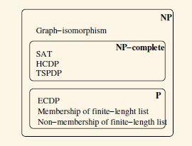

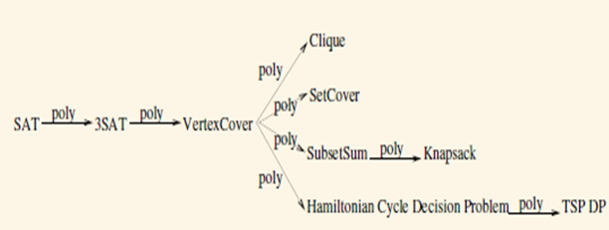
P-NP-NPC-NPH

Slide 55
Thank You halder@iitp.ac.in

